Slide 1
Traffic Lights Manager
Project Core phase June 2016

Slide 2
Who we are?
Teamwork always wins!
Bilger Yahov
Georgi Chishirkov
Ilia Nikushev
Lyubomir Dimov
Mengchuan Liu
Oleksandr Suprunenko

Slide 3
Contents
Initial problem definition
Gathering requirements from the client
Preparation of documents and agreements
Initializing the project development
Final solution
Demo time!

Slide 4
Initial problem definition
Mr. George – mayor of C Sharp city, unhappy about the traffic problems
The initial idea is to place some traffic lights
Of course before doing that it’s essential to investigate if these traffic lights wont cause too many traffic jams

Slide 5

Ideal world

Slide 6
Gathering requirements from the client
Assured by:
Regular meetings
Proper arrangements
Keeping minutes
Preparing agendas

Slide 7
Preparation of documents and agreements
Documentation signed:
Project Plan
User Requirements Specification
Test Plan
Design Document

Slide 8
Create a simulation
User prompts the system to create a new simulation.
System empties the grid.
Extensions:
1a.Current grid is not empty.
1a1. System prompts the user to save their changes. 1a2. Case continues with 2.
1b.Current grid is empty. 1b1. System does nothing.

Slide 9
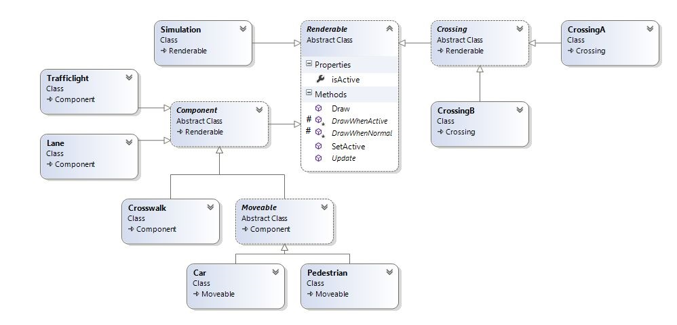

Slide 10
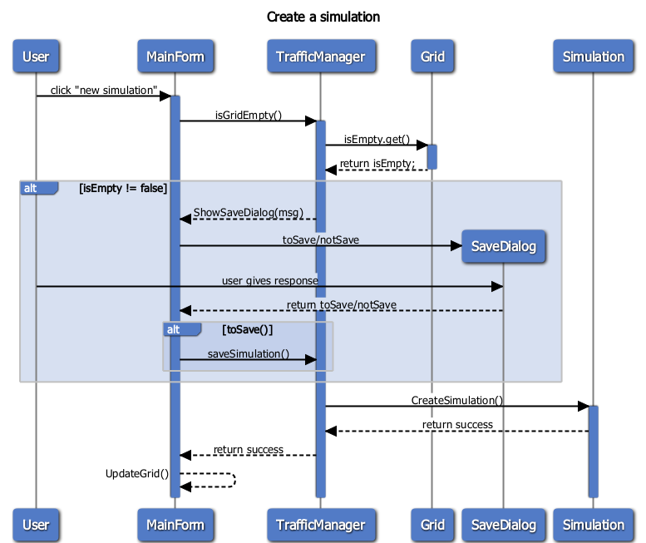

Slide 11
Tough story right?

Slide 12

Initializing the project development
Considering development tools
Platform
IDE
Language
Techniques and Patterns

Slide 13



Slide 14
Final solution
Main functional parts:
Real life traffic simulation
Three different types of crossroads
Nine free slots for crossroads
Traffic lights

Slide 15
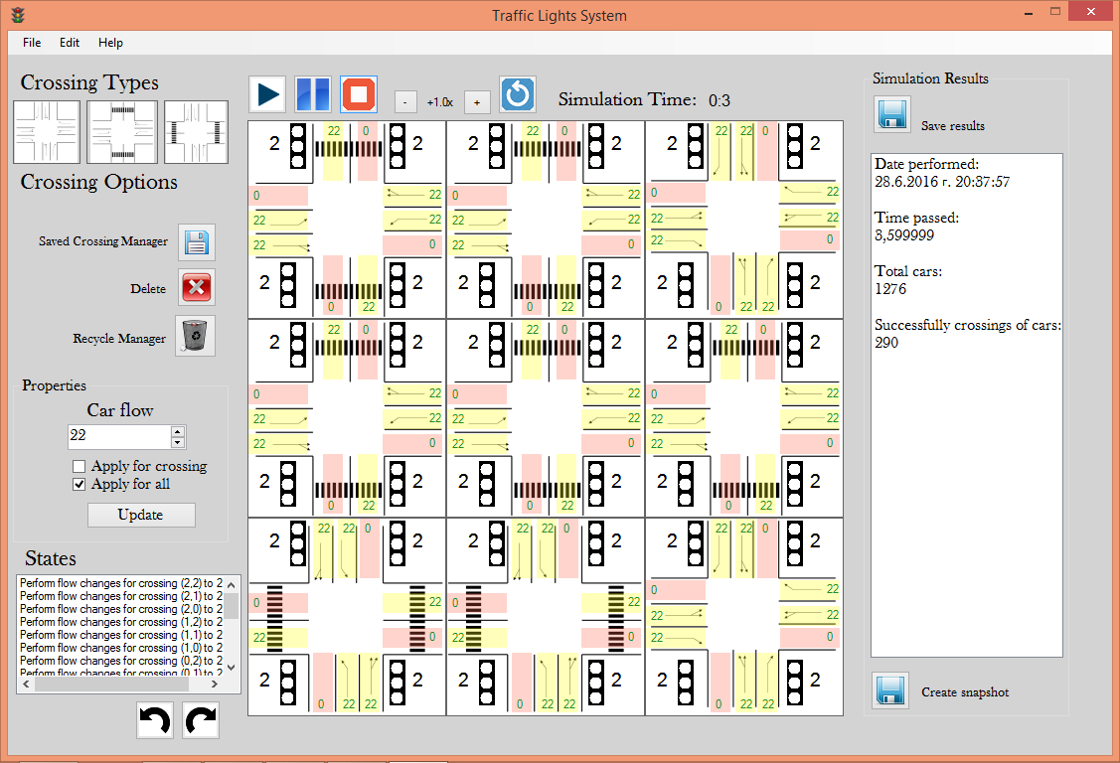

Slide 16
Final solution
Easy to change and modify
Undo/ Redo
Set simulation speed
Save/Load grid
Save results
Export to Excel!
Make a screenshot!

Slide 17
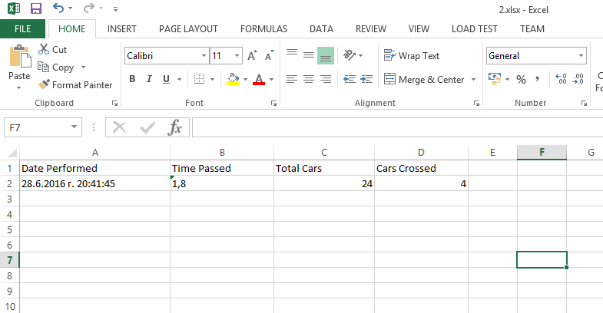

Slide 18
Seems cool right?
Then let us demo it!

